Slide 1
LUNG CANCER PREDICTION USING PREDICTIVE ANALYTICS
GUIDE DETAILS: STUDENT DETAILS:
Er Sathish R AP/IT Nandhisha S Nivetha M Sudha P

Slide 2
ABSTRACT:
Cancer which can be defined as a disease in which an abnormal cells divide uncontrollably and destroy body tissue. Lung cancer is the most common killer and plays an important role in mortality of vast amount of people. Lung cancer is the second most common cancer among others. Major reason for lung cancer is due to smoking. To prevent lung cancer deaths, high risk individuals are being screened with low-dose CT scans, because early prediction doubles the survival rate of lung cancer patients. Automatically identifying cancerous lesions in CT scans will save radiologists a lot of time. It will make diagnosing more affordable and hence will save many more lives. Currently lung cancer is predicting by using MRI scan and CT scans. We proposed a new system to predict lung cancer using textual data. In particular, we investigated sex, variables related to smoking history and addiction to nicotine, personal medical history, family history of lung cancer etc. In this work, we use supervised learning algorithms namely logistic regression, k-nearest neighbour etc., to predict lung cancer. Aim of the project is to propose a model for early prediction and correct diagnosis of the disease which will help the doctor in saving the life of the patient.
Keywords: Lung cancer, CT scans, MRI scans, Textual data, Supervised learning algorithm, Logistic regression, K-nearest neighbour.

Slide 3
SURVEY PAPER:
https://docs.google.com/document/d/1euf4J6ocUTqgL05apzeHcQpaUwBN_7CuwJHMLltSJwY/edit
IMPLEMENTATION PAPER:
https://docs.google.com/document/d/1nBhyGh5lc31jIRisHSk5HpSwrMYDIB7iUtjMDaaXMXs/edit#

Slide 4
MODULES
Data collection module
Data preparation module
Apply model
Training module
Model Evaluation and testing module
Predictive analysis

Slide 5
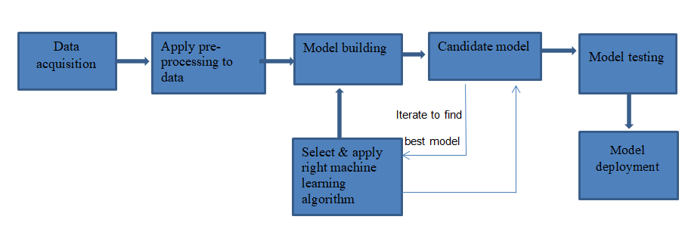
ARCHITECTURE DIAGRAM

Slide 6
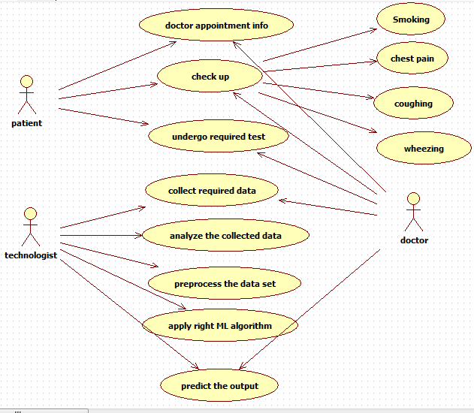
USE CASE DIAGRAM

Slide 7
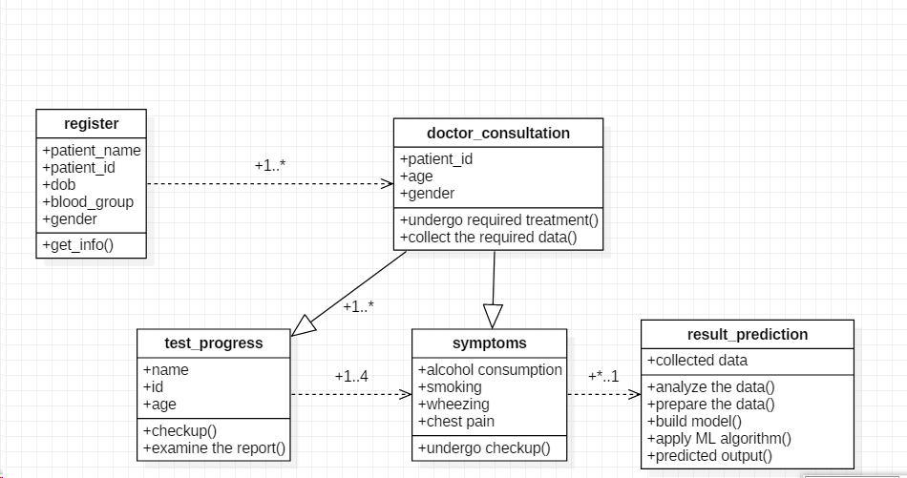
CLASS DIAGRAM

Slide 8
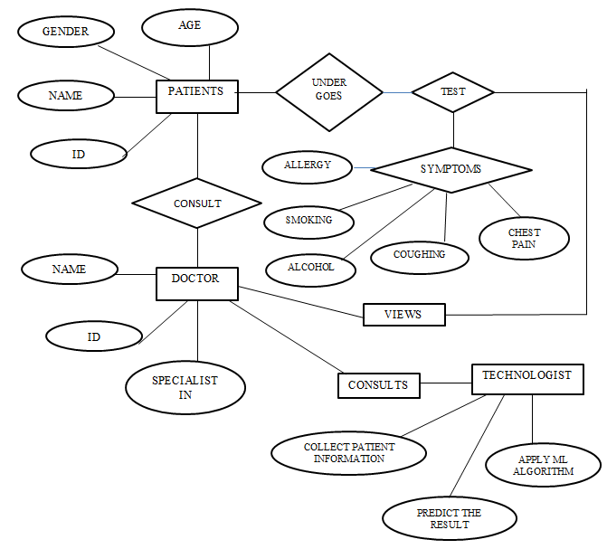
ER DIAGRAM

Slide 9
REQUIREMENT ANALYSIS
Data Collection :
Dataset is needed to predict lung cancer
Data Preparation :
The dataset is splitted into testing data and training data
Apply model:
To find out the accuracy of algorithms and help to make further proceedings
Training module:
The model is trained with help of training dataset
Model Evaluation and testing:
The model is fed with new algorithm and will be tested
Predictive analysis:
This will find out the prediction result whether the person is affected with lung cancer or not.

Slide 10
DATA COLLECTION:
Our dataset contains the lung cancer symptoms and it contains numerical values(1 & 2)
1 = patient is affected and 2=patient is not affected. The attributes in dataset are
ATTRIBUTES
PATIENT ID
GENDER
AGE
ALCOHOL CONSUMING
SMOKING
PEER PRESSURE
FATIGUE
ALLERGY
CHRONIC DISEASE
COUGHING
SHORTNESS OF BREATH
SWALLOWING DIFFICULTY
CHEST PAIN
YELLOW FINGERS
ALCOHOL CONSUMING
WHEEZING

Slide 11
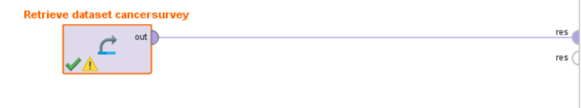
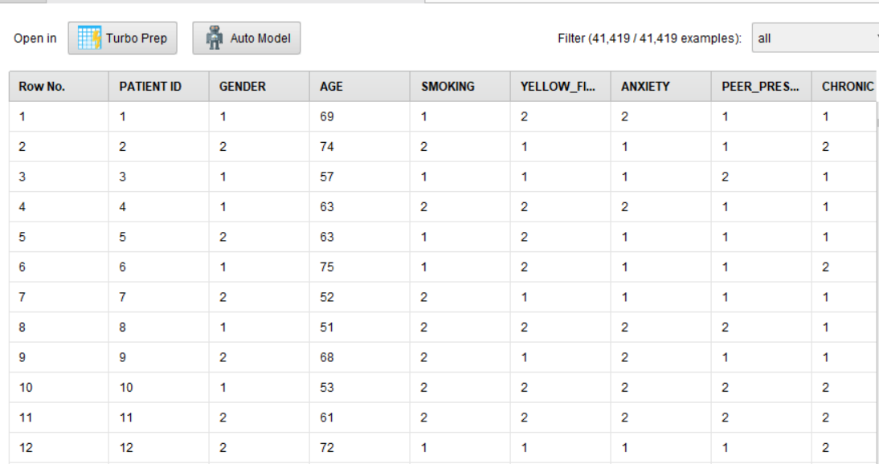
DATA COLLECTION:

Slide 12
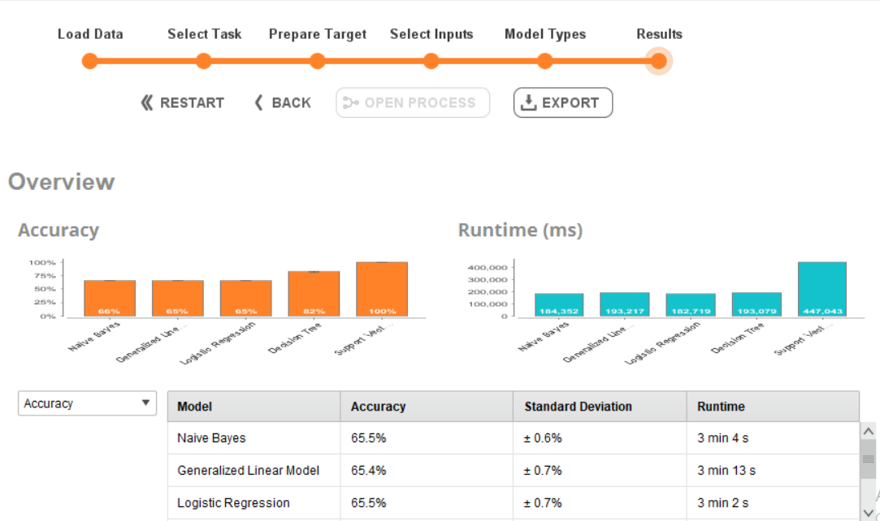
COMPARISON BETWEEN ALGORITHMS:

Slide 13
NAIVE BAYES
Naive Bayes is a simple, yet effective and commonly-used, machine learning classifier.
Naive Bayes classifiers have been especially popular for text classification, and are a traditional solution for problems such as spam detection.
Naive Bayes classifier performs better compare to other models like logistic regression and you need less training data
Naive Bayes is an eager learning classifier and it is sure fast. Thus, it could be used for making predictions in real time.

Slide 14
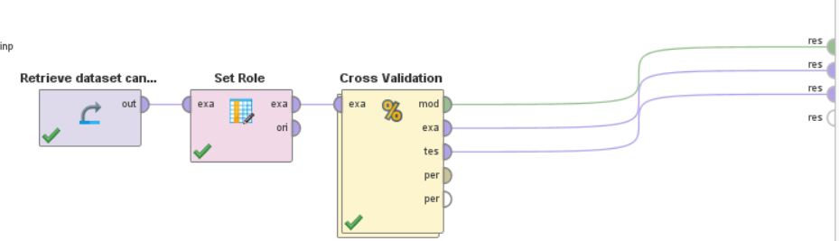
NAIVE BAYES ALGORITHM(Contd)

Slide 15
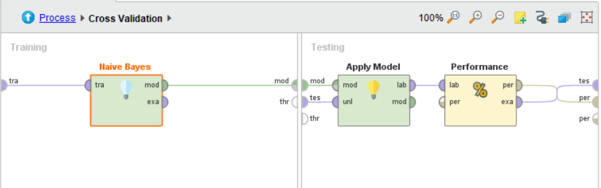
NAIVE BAYES ALGORITHM(Contd)

Slide 16
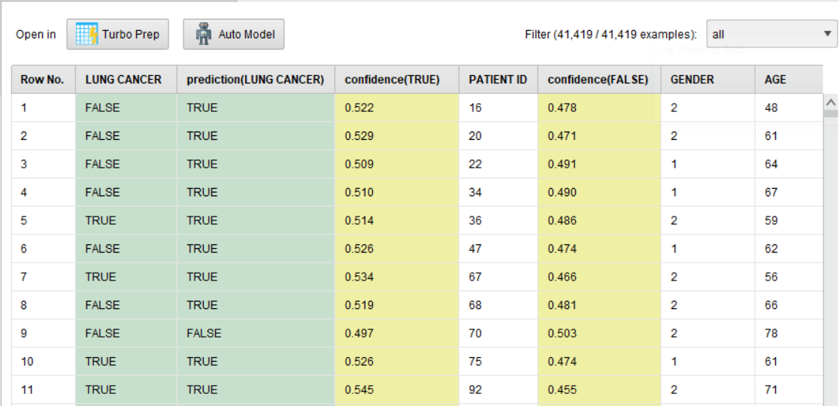
NAIVE BAYES ALGORITHM(Contd)

Slide 17
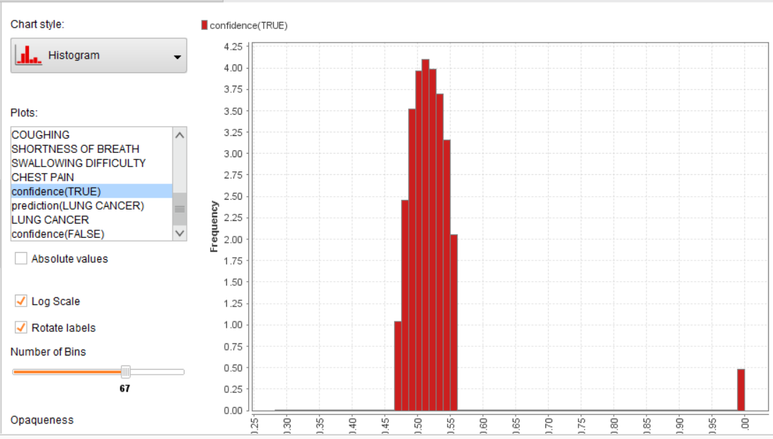
NAIVE BAYES ALGORITHM(Contd)

Slide 18
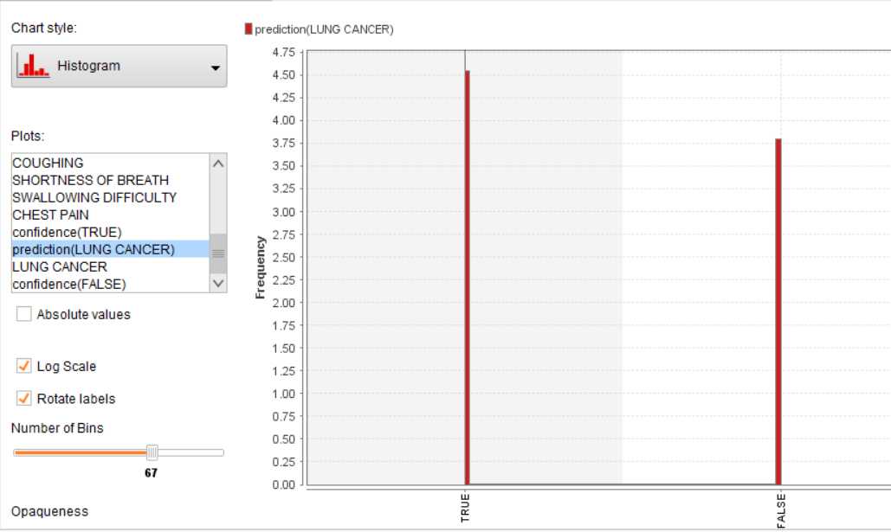
NAIVE BAYES ALGORITHM(Contd)

Slide 19
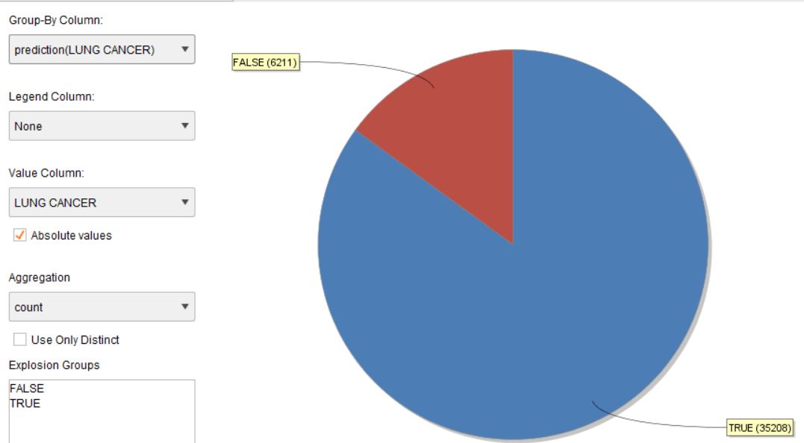
NAIVE BAYES ALGORITHM(Contd)

Slide 20
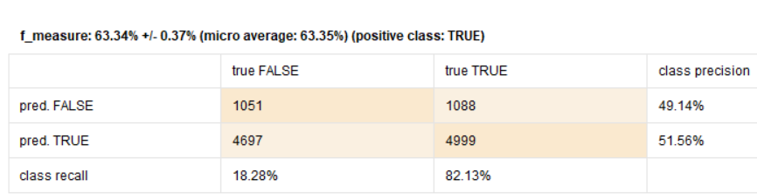
NAIVE BAYES ALGORITHM(Contd)-performance

Slide 21
LOGISTIC REGRESSION
Logistic regression is a statistical method for analyzing a dataset in which there are one or more independent variables that determine an outcome.
It is used to describe data and to explain the relationship between one dependent binary variable.
The idea of Logistic Regression is to find a relationship between features and probability of particular outcome.

Slide 22
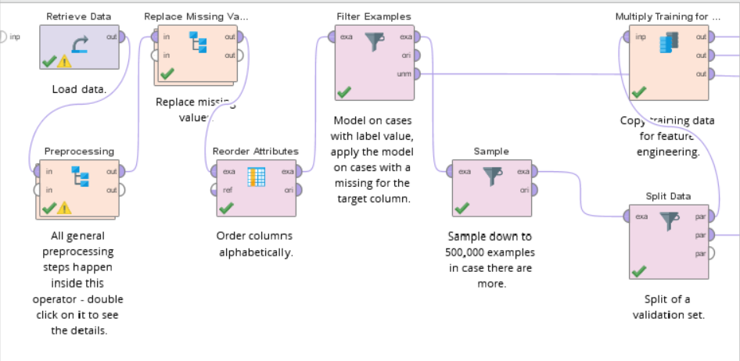
LOGISTIC REGRESSION(Contd):

Slide 23
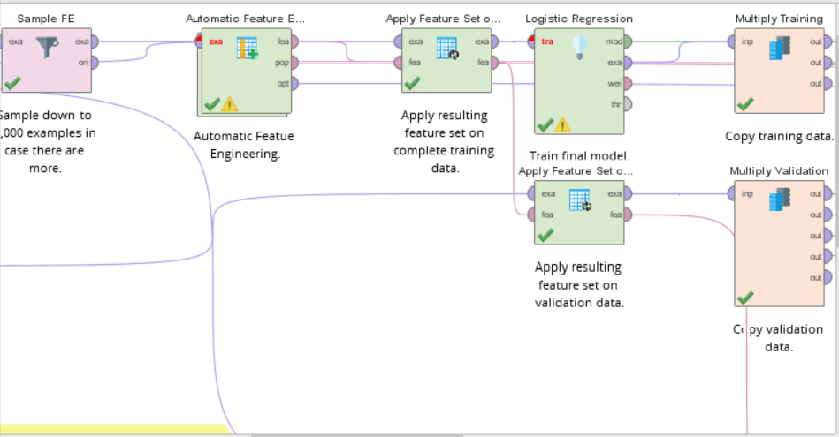
LOGISTIC REGRESSION(Contd)

Slide 24
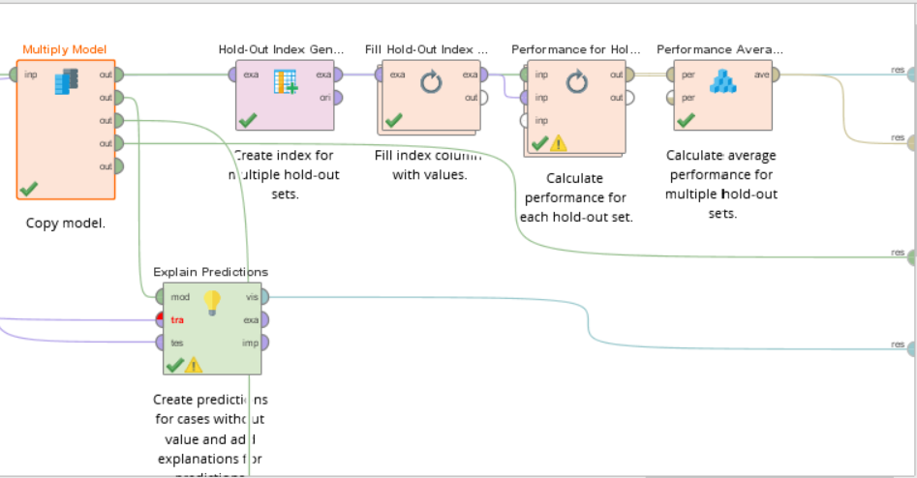
LOGISTIC REGRESSION(Contd)

Slide 25
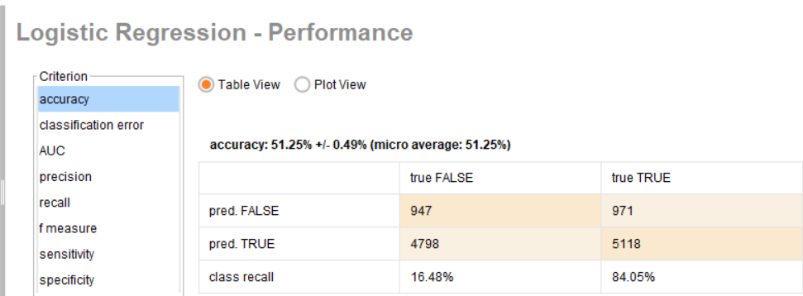
LOGISTIC REGRESSION(Contd)

Slide 26
GOOGLE FORM:
https://docs.google.com/forms/d/1MZoVB9n1Y2ksa093-JWsqeDUtbWrjBAlyBE1EdtJ_xQ/edit

Slide 27
CONCLUSION
Lung Cancer is menacing cancer in the world with high mortality rate. It helps the society to change the lifestyle of the human being to avoid such malignant disease. We have applied data preprocessing techniques on our dataset for removing of noise and dirty data, dirty data is a common term in data mining. This project mainly focuses on predicting the lung cancer based on survey using machine learning algorithms. This project compares various techniques based on efficiency in classification in order to predict lung cancer.

Slide 28
THANK YOU

